Slide 1

Implementation of DCVF
Pravin Kumar Rana
Sound and Image Processing Lab.(SIP)
KTH - Royal Institute of Technology
SE-10044 Stockholm, Sweden

Slide 2

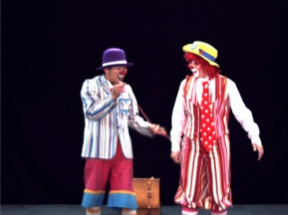
Disparity Information
Using NDE reference software
Nagoya Depth Estimation
Reference Software
pantomime39
Error
Information
pantomime40
pantomime39

Slide 3
Disparity Vector Field
Disparity information from the NDE reference software

Slide 4
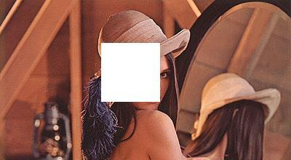
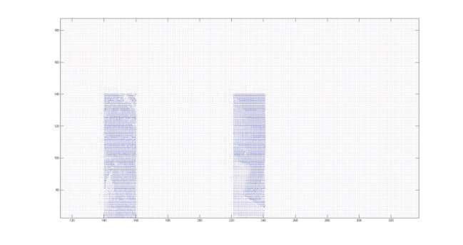
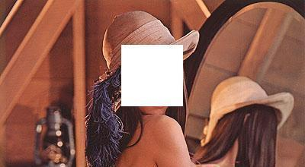
Disparity Information
Using NDE reference software
Nagoya Depth Estimation
Reference Software
lena_white_left
Error
Information
lena_white_right
lena_white_left

Slide 5
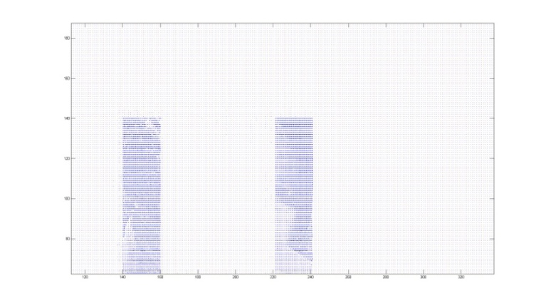

Disparity Vector Field
Synthetic disparity information
20 pixel
20 pixel

Slide 6
Disparity Compensated View Filter (DCVF)
Common View
Error
Disparity Compensated View Filter
(DCVF)
Disparity
Field Information
( DF ₁ ₂ )
View 1
View 2

Slide 7
Disparity Compensated View Filter (DCVF)
Common View
Error
Disparity Compensated View Filter
(DCVF)
Disparity
Field Information
( DF ₁ ₂ )
View 1
View 2

Slide 8
Disparity Vector Field
Synthetic disparity information

Slide 9
DCVF Output
Common View
Error View
Using synthetic disparity information : -20 -20 pixel shift

Slide 10
Disparity Information
Synthetic disparity information

Slide 11
DCVF Output
Common View
Error View
Using synthetic disparity information : -20 pixel shift for all block pixel

Slide 12
DCVF Output
Common View
Error View
Using the NDE reference software information

Slide 13
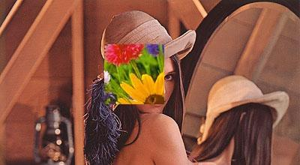
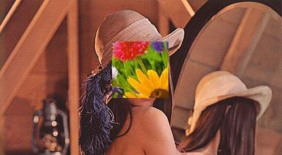
Disparity Compensated View Filter (DCVF)
Common View
Error
Disparity Compensated View Filter
(DCVF)
Disparity
Field Information
( DF ₁ ₂ )
View 1
View 2

Slide 14
DCVF Output
Common View
Error View
Using synthetic disparity information : 20 pixel shift

Slide 15
Disparity Information
disparity information from the NDE reference software

Slide 16
DCVF Output
Common View
Error View
Using the NDE reference software information

Slide 17
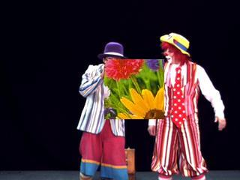
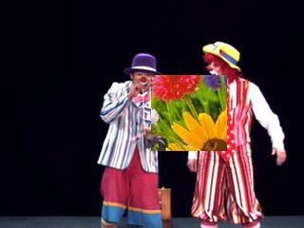
Disparity Compensated View Filter (DCVF)
Common View
Error
Disparity Compensated View Filter
(DCVF)
Disparity
Field Information
( DF ₁ ₂ )
View 1
View 2
Pantomime test data with 20 pixel disparity in texture block

Slide 18
DCVF Output
Common View
Error View
Using the NDE reference software information

Slide 19
Disparity Compensated View Filter (DCVF)
Common View
Error
Disparity Compensated View Filter
(DCVF)
Disparity
Field Information
( DF ₁ ₂ )
pantomime39
pantomime40
Pantomime test data with fixed texture block

Slide 20
Disparity Information
disparity information from the NDE reference software

Slide 21
DCVF Output
Common View
Error View
Using the NDE reference software information

Slide 22
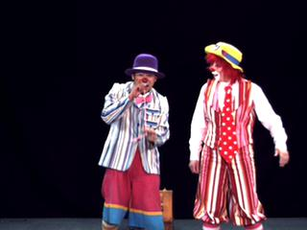
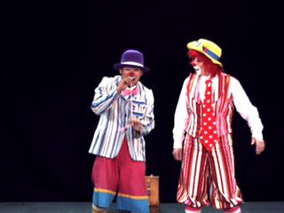
Disparity Compensated View Filter (DCVF)
Common View
Error
Disparity Compensated View Filter
(DCVF)
Disparity
Field Information
( DF ₁ ₂ )
pantomime39
pantomime40

Slide 23
DCVF Output
Common View
Error View
Using the NDE reference software information

Slide 24
Epipolar Geometry
Point of interest
common point
1 2 3 4

Slide 25
Epipolar Geometry
Checking visible points
Condition for relay points :
Point of interest
Object
relay point
common point
1 2 3 4

